Slide 1

Multithreading MPI Communication
Nicolae-Andrei Vasile

Slide 2


OVERVIEW
processor development is clearly heading to an era where chips comprising multiple processor cores (tens or even hundreds) are ubiquitous
parallel systems are increasingly being built with multiple CPU cores on a single node, all sharing memory
researchers are evaluating other programming models that involve fewer MPI processes per node and use threads to exploit loop-level and other parallelism
MPI implementations have traditionally not provided highly tuned support for multithreaded MPI communication (some implementations do not support thread safety – Microsoft MPI, NEC MPI, IBM MPI for Blue Gene/L – others do – MPICH, Open MPI)
designing an efficient, thread-safe MPI implementation is a nontrivial task

Slide 3
THREAD SAFETY IN MPI
for performance reasons, MPI defines four “levels” of thread safety, and allows the user to indicate the level desired:
MPI_THREAD_SINGLE: each process has a single thread of execution
MPI_THREAD_FUNNELED: a process may be multithreaded, but only the thread that initialized MPI may make MPI calls
MPI_THREAD_SERIALIZED: a process may be multithreaded, but only one thread at a time may make MPI calls
MPI_THREAD_MULTIPLE: a process may be multithreaded, and multiple threads may simultaneously call MPI functions (with some restrictions mentioned below)
the idea is that the implementation does not need to incur the cost for a higher level of thread safety than the user needs

Slide 4
CHOICES OF CRITICAL-SECTION GRANULARITY
to support multithreaded MPI communication, the implementation must protect certain data structures and portions of code from being accessed by multiple threads simultaneously in order to avoid race conditions
a portion of code so protected is called a critical section
the granularity (size) of the critical section and the exact mechanism used to implement the critical section can have a significant impact on performance
a critical section can be implemented either by using mutex locks or in a lock-free manner by using assembly-level atomic operations such as compare-and-swap or fetch-and-add

Slide 5
four approaches to the selection of critical-section granularity in a thread-safe MPI implementation:
Global: there is a single, global critical section that is held for the duration of most MPI functions, except if the function is going to block on a network operation
Brief Global: there is a single, global critical section, but it is held only when required; this approach permits concurrency between threads making MPI calls, except when common internal data structures are being accessed
Per Object: there are separate critical sections for different objects and classes of objects
Lock Free: instead of critical sections, lock-free (or wait-free) synchronization methods, are implemented by using atomic operations that exploit processor specific features; this approach offers the potential for improved performance and greater concurrency; complexity-wise, it is the hardest of the four

Slide 6
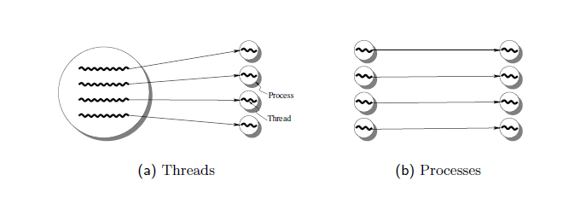
PERFORMANCE EXPERIMENTS
to assess the performance of each granularity option, a test that measures the message rate achieved by n threads of a process sending to n single-threaded receiving processes was used
the receiving processes prepost 128 receives using MPI_Irecv, send an acknowledgment to the sending threads, and then wait for the receives to complete.
after receiving the acknowledgment, the threads of the sending process send 128 messages using MPI_Send

Slide 7
Performance with MPI_PROC_NULL
This test is intended to measure the threading overhead in the MPICH code in the absence of any network communication
we use MPI_PROC_NULL as the destination in MPI_Send and as a source in MPI_Irecv
MPI_Send to MPI_PROC_NULL is handled at a layer above the device-specific code and does not involve manipulation of any shared data structures

Slide 8
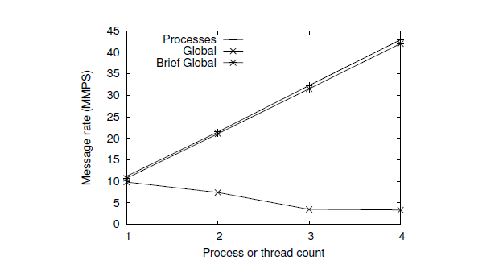
in the multiple-process case, the message rate increases with the number of senders because there is no contention for critical sections
in the multithreaded case with Brief Global, the performance is almost identical to multiple processes because Brief Global acquires critical sections only as needed
there is a significant decline in message rate with the Global mode, because, in this mode, a critical section is acquired on entry to an MPI function

Slide 9
Performance with Blocking Sends
this test measures the performance when the communication path is exercised, which requires critical sections to be acquired
the test measures the message rate for zero-byte blocking sends

Slide 10
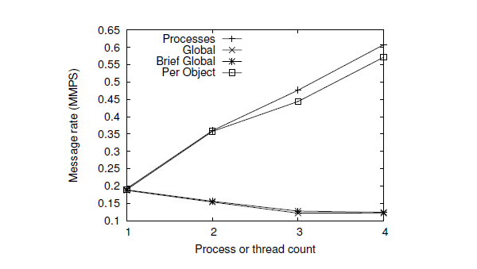
because of the cost of communication, the overall message rate is considerably lower than with MPI_PROC_NULL
Brief Global performs as poorly as Global, because it acquires a large critical section during communication, which dominates the overall time
Per Object granularity demonstrated very good performance, because the granularity of critical sections in this case is per virtual channel (VC), rather than global

Slide 11
Performance with Nonblocking Sends
when performing a blocking send for short messages, it is not needed to allocate an MPI_Request object
for nonblocking sends, however, a request object must be allocated to keep track of the progress of the communication operation
requests are allocated from a common pool of free requests, which must be protected by a critical section
each request object also uses a reference count to determine when the operation is complete and when it is safe to free the object

Slide 12
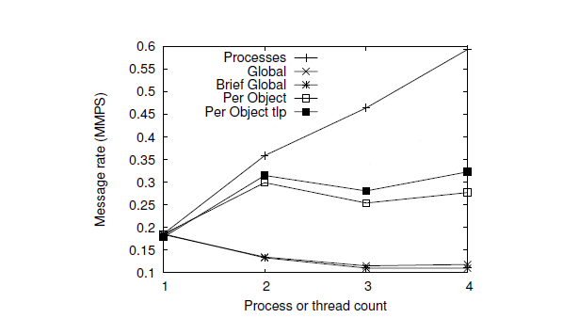
the performance of Per Object granularity is significantly affected by the contention on the request pool, and the message rate does not increase beyond more than two threads
the graph labeled “Per Object tlp” shows that by adding the thread-local request pool, the message rate improves, but only slightly
the contention for the reference-count updates still hurts

Slide 13
CONCLUSION
we have discussed several issues that an implementation must consider when implementing thread safety in MPI
some of the issues are subtle, but nonetheless important
we have presented several approaches to reduce the critical-section granularity, which can impact performance significantly
careful thought and analysis are required in order to implement thread safety correctly and without sacrificing too much performance

Slide 14

THANK YOU
Q&A

